Slide 1
Operating Systems
Chapter 2 (b)
Operating System Structures
Hammad Afzal
hammad.afzal@mcs.edu.pk
Computer Science Department
College of Telecommunication Engineering
National University of Sciences and Technology

Slide 2
Chapter 2: Roadmap
System Programs
Operating System Design and Implementation
Operating System Structure

Slide 3
System Programs
Also known as System Utilities
System programs provide a convenient environment for program development and execution.
In some cases, simply user interfaces to system calls.
Most users’ view of the operating system is defined by system programs, not the actual system calls

Slide 4
System Programs
System Programs can be divided into:
File manipulation
Status information
File modification
Programming language support
Program loading and execution
Communications
Application programs

Slide 5
System Programs
File management
Create, delete, copy, rename, print, dump, list, and generally manipulate files and directories

Slide 6
System Programs
Status information
Some ask the system for info - date, time, amount of available memory, disk space, number of users
Others provide detailed performance, logging, and debugging information
Typically, these programs format and print the output to the terminal or other output devices
Some systems implement a registry - used to store and retrieve configuration information

Slide 7
System Programs (Cont.)
File modification
Text editors to create and modify files
Special commands to search contents of files or perform transformations of the text
Programming-language support
System provides Compilers, assemblers, debuggers and interpreters sometimes provided

Slide 8
System Programs (Cont.)
Program loading and execution
System may provide loaders, linkers, debugging systems for higher-level and machine language
Communications
Provide the mechanism for creating virtual connections among processes, users, and computer systems
Allow users to send messages to one another’s screens, browse web pages, send electronic-mail messages, log in remotely, transfer files from one machine to another

Slide 9
Operating System Design and Implementation
Internal structure of different Operating Systems can vary widely
Affected by choice of hardware, type of system
Batch, time shared, single user, multi-user etc
Start by defining goals and specifications
Requirements can be divided into
User goals and System goals
User goals – operating system should be convenient to use, easy to learn, reliable, safe, and fast
System goals – operating system should be easy to design, implement, and maintain, as well as flexible, reliable, error-free, and efficient
However, no unique way to achieve these.
General Principles of Software Engineering Applies

Slide 10
Operating System Design and Implementation (Cont.)
Important principle to separate
Policy: What will be done?
Mechanism: How to do it?
E.g. Timer construct:
Policy: Implement timer for CPU protection
Mechanism: How long timer should be set.
Mechanisms determine how to do something, policies decide what will be done
The separation of policy from mechanism is a very important principle, it allows maximum flexibility if policy decisions are to be changed later

Slide 11
Operating System Design and Implementation (Cont.)
Worst case: Each change in policy results in change of mechanisms.
Best design: Changes only in parameters.
E.g. giving priority to certain types of programs. I/O vs CPU intensive.
Two Extremes of approaches:
Microkernel based OS implement basic set of primitive building blocks.
Completely Policy free.
More policy oriented modules via system programs.
E.g. History of Time sharing in UNIX.
Windows: fixed policy and mechanism.
Strict policy and mechanisms:
All apps having same interfaces, interfaces built into kernel and system libraries.

Slide 12
Operating System Design and Implementation (Cont.)
OS Implementation
Previously in assembly language, now in C, C++
Windows and Linux are mostly in C.
Small codes in assembly as well such as device drivers, for saving and restoring the states of registers.
MS-DOS was implemented in Intel 8080 Assembly language.
Disadv: Only runnable by systems that have similar architecture.
OS in high level languages are easy to port to new hardware.
Disadv: Reduces speed and increased storage requirements.

Slide 13
Operating System Structure
General guideline: Partition the task in smaller components with defined input, output and function.
Read from Book As Well for Details

Slide 14
Simple Structure
MS-DOS – written to provide the most functionality in the least space
Not divided into modules: Interfaces and levels of functionality are not well separated.
E.g. Application programs are able to access the basic I/O routines and write directly to display and disk drives.
Was also limited by hardware of that era. No dual mode, hardware protection.

Slide 15
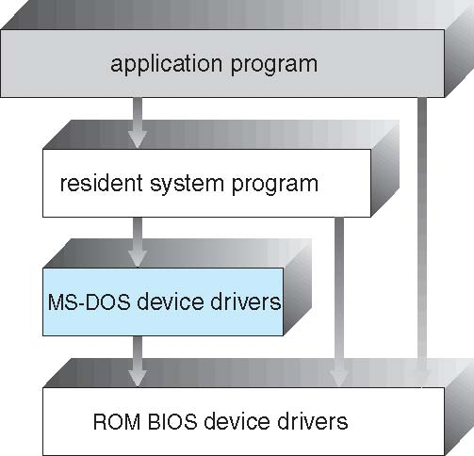
MS-DOS Layer Structure

Slide 16
Simple Structure
Original UNIX – limited by hardware functionality, limited structuring.
The UNIX OS consists of two separable parts
Systems programs
The Kernel
Series of interfaces and device drivers (added and expanded over time).
Consists of everything below the system-call interface and above the physical hardware
Provides the file system, CPU scheduling, memory management, and other operating-system functions; a large number of functions for one level

Slide 17
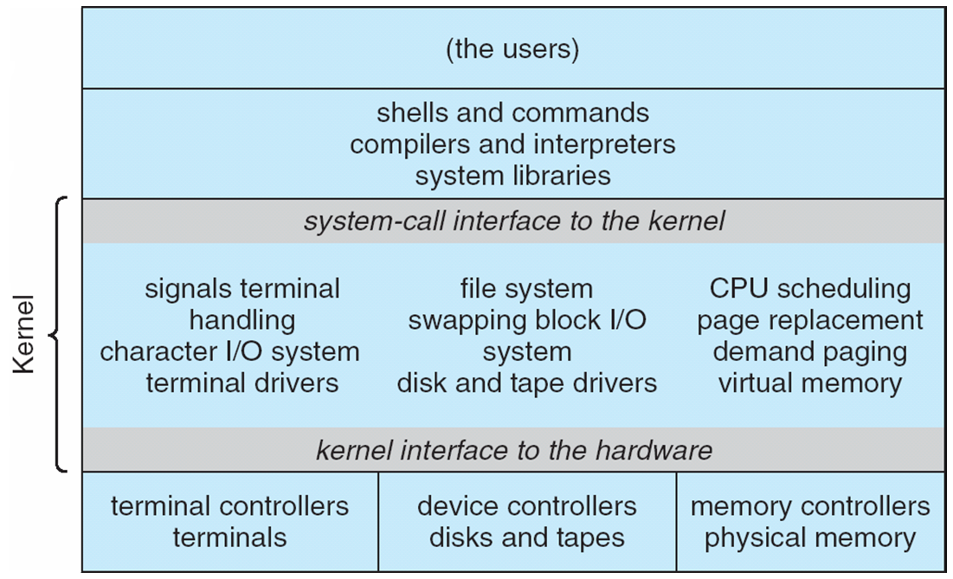
Traditional UNIX System Structure

Slide 18
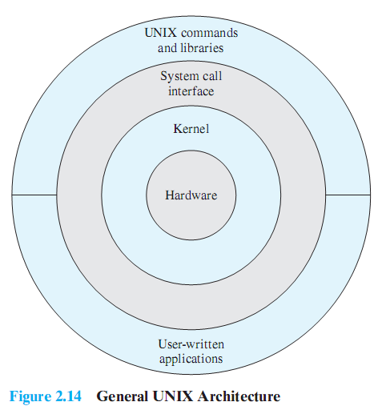
Traditional UNIX System Structure
Notes:
This figure provides a general description of the classic UNIX architecture.
The underlying hardware is surrounded by the OS software.
The OS is often called the system kernel, or simply the kernel, to emphasize its isolation from the user and applications.
It is the UNIX kernel that we will be concerned with in our use of UNIX as an example in this book.
UNIX also comes equipped with a number of user services and interfaces that are considered part of the system.
These can be grouped into the shell, other interface software, and the components of the C compiler (compiler, assembler, loader).
The layer outside of this consists of user applications and the user interface to the C compiler.

Slide 19
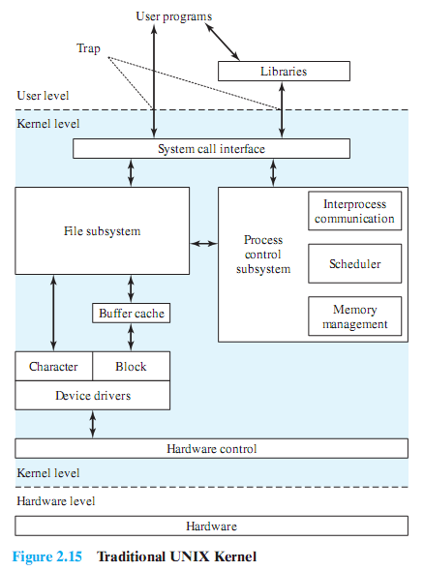
Traditional UNIX System Structure
Notes:
User programs can invoke OS services either directly or through library programs.
The system call interface is the boundary with the user and allows higher-level software to gain access to specific kernel functions.
At the other end, the OS contains primitive routines that interact directly with the hardware.
Between these two interfaces, the system is divided into two main parts, one concerned with process control and the other concerned with file management and I/O.
The process control subsystem is responsible for memory management, the scheduling and dispatching of processes, and the synchronization and interprocess communication of processes.
The file system exchanges data between memory and external devices either as a stream of characters or in blocks. To achieve this, a variety of device drivers are used.
For block-oriented transfers, a disk cache approach is used: a system buffer in main memory is interposed between the user address space and the external device.

Slide 20
Layered Approach
OS is divided into a number of layers (levels), each built on top of lower layers.
The bottom layer (layer 0), is the hardware; the highest (layer N) is the user interface.
OS layer is an implementation of an abstract object made of data and operations.
A typical layer has set of data and routines that can be invoked by higher level layers.
Simplicity of construction.
Notes:
Ideally, the levels should be defined so that changes in one level do not require changes in other levels.
Thus, we have decomposed one problem into a number of more manageable subproblems.

Slide 21
Layered Approach
With modularity, layers are selected such that each uses functions (operations) and services of only lower-level layers
Layers are debugged at one level (assuming the lower layers are correct).
Each layer is implemented with operations provided by lower layers.
Details of lower layers hidden. Only Whats are known, no Hows.

Slide 22
Layered Approach
Powerful Planning is required while designing layered OS.
E.g. Routines to handle VM (data backing store) should be lower than the Memory Management Module.
Tend to be less efficient than other types.
Data and control passes through many layers.

Slide 23
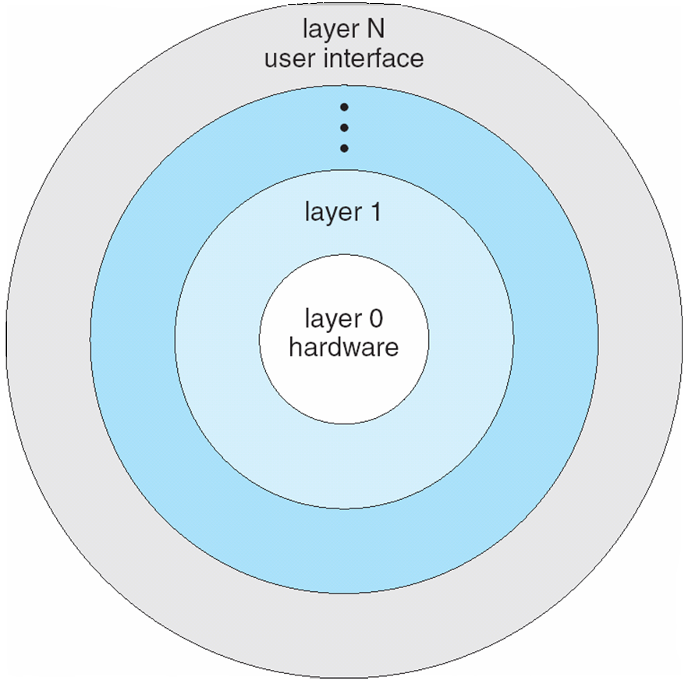
Layered Operating System

Slide 24
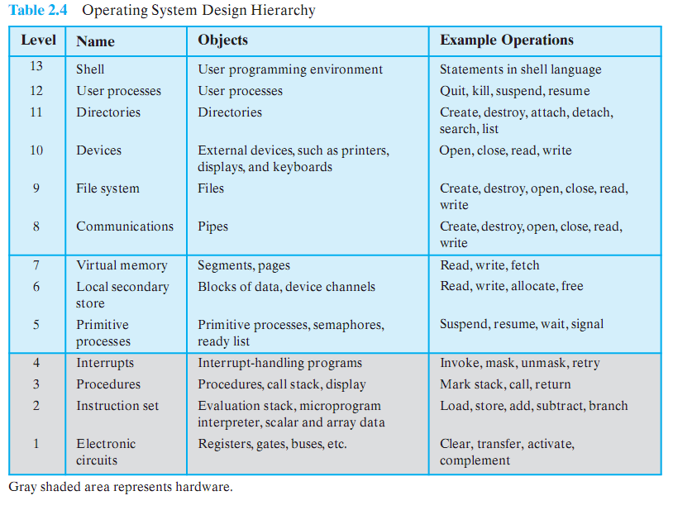
One possible view of an OS with layered approach
Notes:
NON OS Levels
Level 1: Consists of electronic circuits,
the objects that are dealt with are registers, memory cells, and logic gates.
The operations defined on these objects are actions, such as clearing a register or reading a memory location.
Level 2: The processor’s instruction set.
The operations at this level are those allowed in the machine language instruction set, such as add, subtract, load, and store.
Level 3: Adds the concept of a procedure or subroutine, plus the call/return operations.
Level 4: Introduces interrupts, which cause the processor to save the current context and invoke an interrupt-handling routine.
LEVELS INVOLVING A SINGLE PROCESSOR
Level 5: The notion of a process as a program in execution is introduced at this level.
The fundamental requirements on the OS to support multiple processes include the ability to suspend and resume processes.
Requires saving hardware registers so that execution can be switched from one process to another.
In addition, if processes need to cooperate, then some method of synchronization is needed.
Level 6: Deals with the secondary storage devices of the computer.
At this level, the functions of positioning the read/write heads and the actual transfer of blocks of data occur.
Level 6 relies on level 5 to schedule the operation and to notify the requesting process of completion of an operation.
Higher levels are concerned with the address of the needed data on the disk and provide a request for the appropriate block to a device driver at level 5.
Level 7: Creates a logical address space for processes.
This level organizes the virtual address space into blocks that can be moved between main memory and secondary memory.
Three schemes are in common use:
using fixed-size pages,
using variable-length segments, and
using both.
When a needed block is not in main memory, logic at this level requests a transfer from level 6.
MULTIPROCESSOR LEVELS
Level 8: Deals with the communication of information and messages between processes.
This level deals with a richer sharing of information.
One of the most powerful tools for this purpose is the pipe, which is a logical channel for the flow of data between processes.
A pipe is defined with its output from one process and its input into another process.
It can also be used to link external devices or files to processes.
Level 9: Supports the long-term storage of named files.
At this level, the data on secondary storage are viewed in terms of abstract, variable-length entities.
Level 10: Provides access to external devices using standardized interfaces.
Level 11: Is responsible for maintaining the association between the external and internal identifiers of the system’s resources and objects.
The external identifier is a name that can be employed by an application or user.
The internal identifier is an address or other indicator that can be used by lower levels of the OS to locate and control an object.
These associations are maintained in a directory.
Entries include not only external/internal mapping, but also characteristics such as access rights.
Level 12: Provides a full-featured facility for the support of processes.
This goes far beyond what is provided at level 5.At level 5, only the processor register contents associated with a process are maintained, plus the logic for dispatching processes.
At level 12, all of the information needed for the orderly management of processes is supported.
This includes the virtual address space of the process, a list of objects and processes with which it may interact and the constraints of that interaction, parameters passed to the process upon creation, and any other characteristics of the process that might be used by the OS to control the process.
Level 13: Provides an interface to the OS for the user.
It is referred to as the shell because it separates the user from OS details and presents the OS simply as a collection of services.
The shell accepts user commands or job control statements, interprets these, and creates and controls processes as needed.
e.g. the interface at this level could be implemented in a graphical manner, providing the user with commands through a list presented as a menu and displaying results using graphical output to a specific device such as a screen.

Slide 25
Microkernel System Structure
In mid, 1980s, Mach removed all non essential components from Unix kernel and implemented them as system or user level programs.
Typically, micro-kernels provide minimal process (scheduling) and memory management (address spaces), in addition to communication (inter process communication) facility.
Provides communication between the client program and various services using message passing.
Services also run in user space

Slide 26
Microkernel System Structure
Benefits:
Easier to extend a microkernel. New services are added to user space and do not require modification of kernel.
Easier to port the operating system to new architectures
More reliable (less code is running in kernel mode). If process fails, rest of OS remains untouched.
More secure
Detriments:
Performance overhead of user space to kernel space communication
Client programs and servers do not interact directly with each other, they do interaction only through micro-kernels messages.

Slide 27
Modules
Current Methodology: Object Oriented Approach.
Kernel has core components and links to additional services either at boot time or run time.
Uses dynamically loadable modules.
Kernel provide core services and certain features to be implemented dynamically.
E.g. Device and Bus drivers, support for different file services.
Each core component is separate and has defined protected interfaces.
Each module talks to the others over known interfaces
Overall, similar to layers but with more flexible

Slide 28
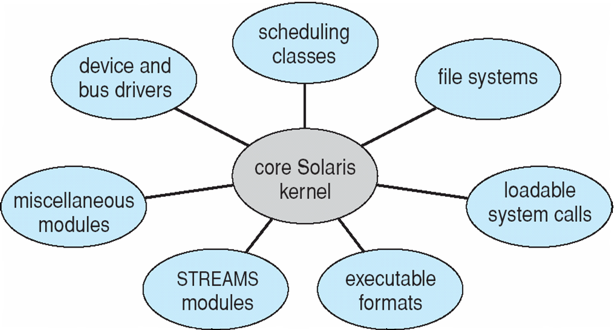
Solaris Modular Approach

Slide 29
End

Slide 30
Modular Monolithic Kernel
Although monolithic, the kernel is structures as a collection of modules
Loadable modules
An object file which can be linked and unlinked at run time
Characteristics:
Dynamic Linking
Stackable modules
Self Study
Notes:
Although Linux does not use a microkernel approach, it achieves many of the potential advantages of this approach by means of its particular modular architecture.
Linux is structured as a collection of modules, a number of which can be automatically loaded and unloaded on demand.
These relatively independent blocks are referred to as loadable modules.
In essence, a module is an object file whose code can be linked to and unlinked from the kernel at runtime.
The Linux loadable modules have two important characteristics:
Dynamic linking: A kernel module can be loaded and linked into the kernel while the kernel is already in memory and executing.
A module can also be unlinked and removed from memory at any time.
Saves kernel memory.
Stackable modules: The modules are arranged in a hierarchy.
Individual modules serve as libraries when they are referenced by client modules higher up in the hierarchy, and as clients when they reference modules further down.

Slide 31
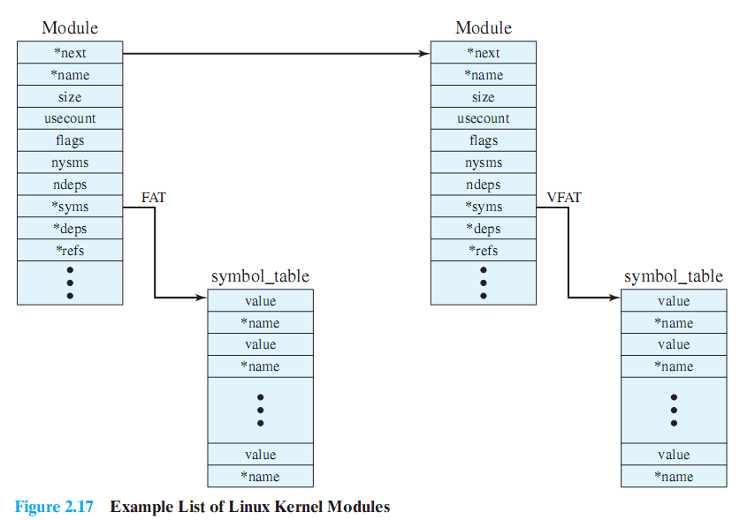
Linux Kernel Modules
Self Study
Notes:
Figure 2.17 is an example that illustrates the structures used by Linux to manage modules.
It shows that the VFAT module was loaded after the FAT module and that the VFAT module is dependent on the FAT module.
The figure shows the list of kernel modules after only two modules have been loaded:
FAT and VFAT.
Each module is defined by two tables,
The module table and
the symbol table.
The module table includes the following elements:
*next: Pointer to the following module. All modules are organized into a linked list.
The list begins with a pseudomodule (not shown in Figure 2.17).
*name: Pointer to module name.
size:Module size in memory pages.
usecount:Module usage counter.
The counter is incremented when an operation involving the module’s functions is started and decremented when the operation terminates.
flags:Module flags.
nsyms: Number of exported symbols.
ndeps: Number of referenced modules
*syms: Pointer to this module’s symbol table.
*deps: Pointer to list of modules the are referenced by this module.
*refs: Pointer to list of modules that use this module.
The symbol table defines those symbols controlled by this module that are used elsewhere.

Slide 32
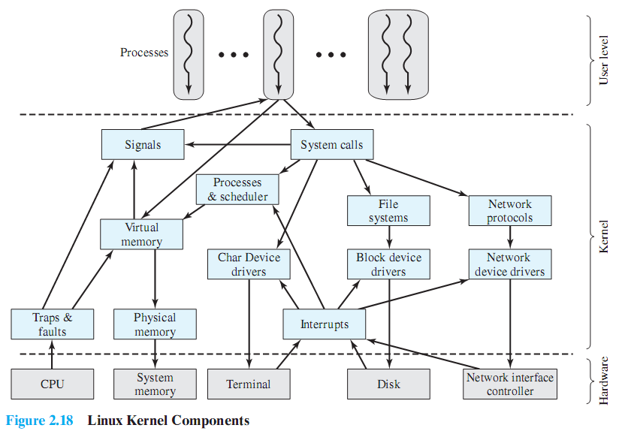
Linux Kernel Components
Self Study
Notes:
This figure shows the main components of the Linux kernel as implemented on an IA-64 architecture (e.g., Intel Itanium).
It shows several processes running on top of the kernel.
Each box indicates a separate process, while each squiggly line with an arrowhead represents a thread of execution.
The kernel itself consists of an interacting collection of components, with arrows indicating the main interactions.
The underlying hardware is also depicted as a set of components with arrows indicating which kernel components use or control which hardware components.
All of the kernel components, of course, execute on the processor but, for simplicity, these relationships are not shown.

Slide 33
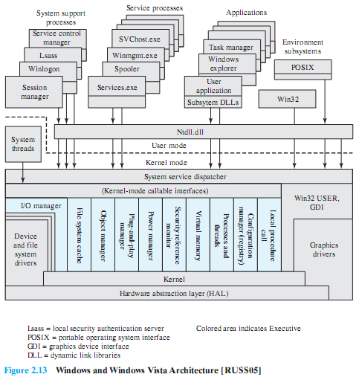
Windows Architecture
Self Study
Notes:
Figure 2.13 illustrates the overall structure of Windows 2000; later releases of Windows, including Vista, have essentially the same structure at this level of detail.
Its modular structure gives Windows considerable flexibility.
Windows separates application-oriented software from the core OS software.
The latter, which includes the Executive, the Kernel, device drivers, and the hardware abstraction layer, runs in kernel mode.
Kernel mode software has access to system data and to the hardware.
The remaining software, running in user mode, has limited access to system data.
Windows has a highly modular architecture.
Each system function is managed by just one component of the OS.
The rest of the OS and all applications access that function through the responsible component using standard interfaces.
Key system data can only be accessed through the appropriate function.
In principle, any module can be removed, upgraded, or replaced without rewriting the entire system or its standard application program interface (APIs).

